Slide 1


Rapid growth of supra-glacial lakes
26 November 2024

Slide 2
Justification
In recent years supra-glacial lakes have drained rapidly and led to flood and debris-flows
Focus is mostly on GLOFs and pro-glacial lakes
Understanding the dynamics requires high temporal and high spatial resolution of satellite imagery

Slide 3
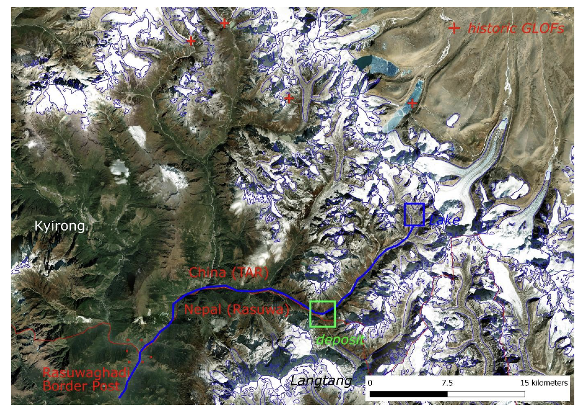
Example: Purepu GLOF (7 July 2025)

Slide 4
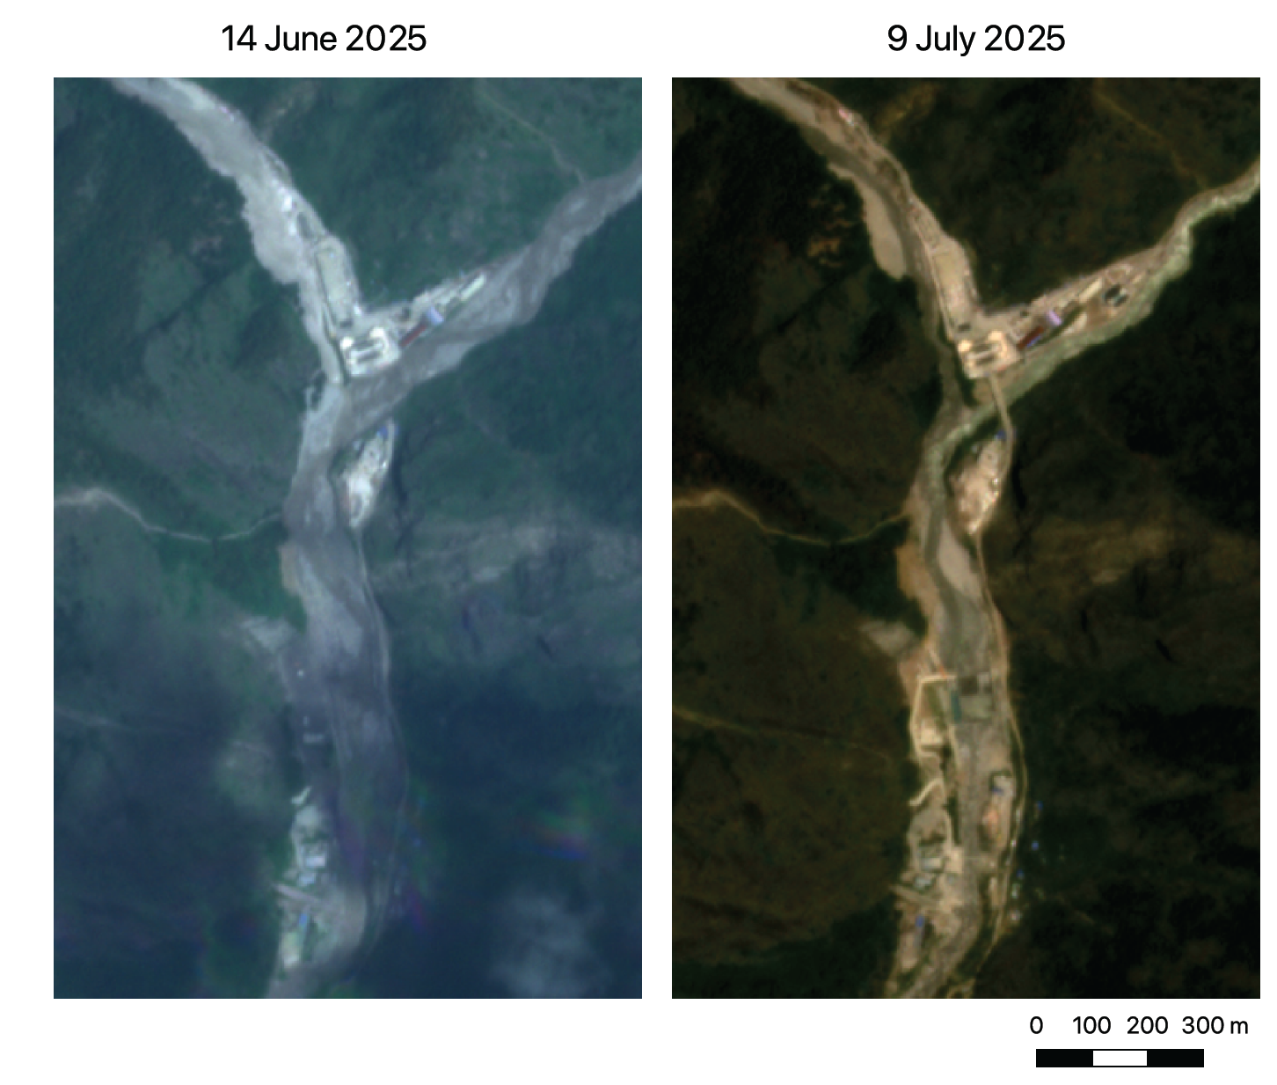

Slide 5
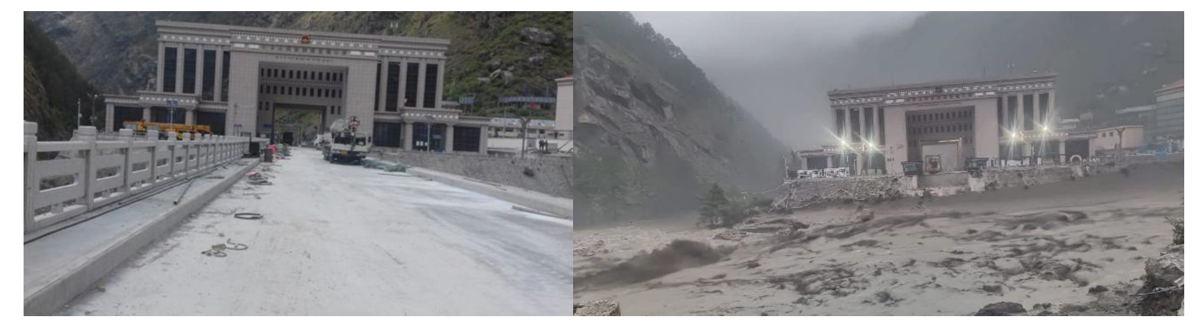
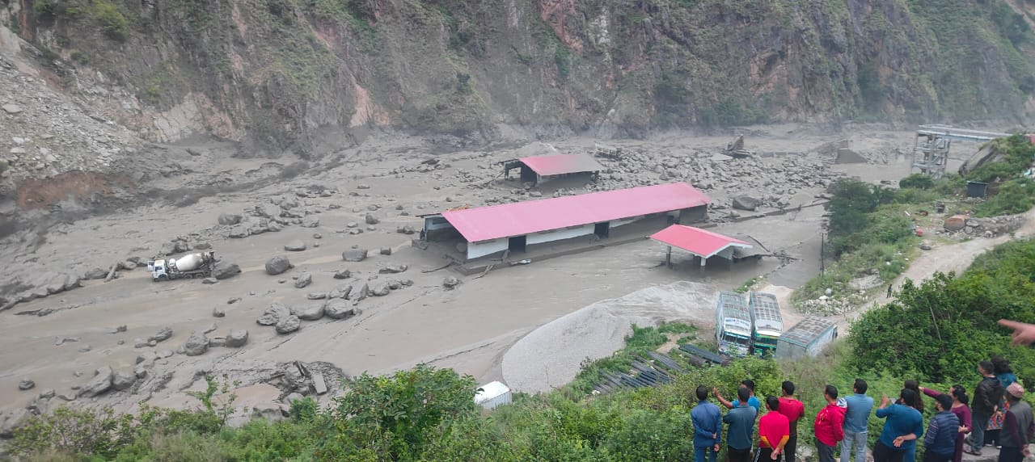
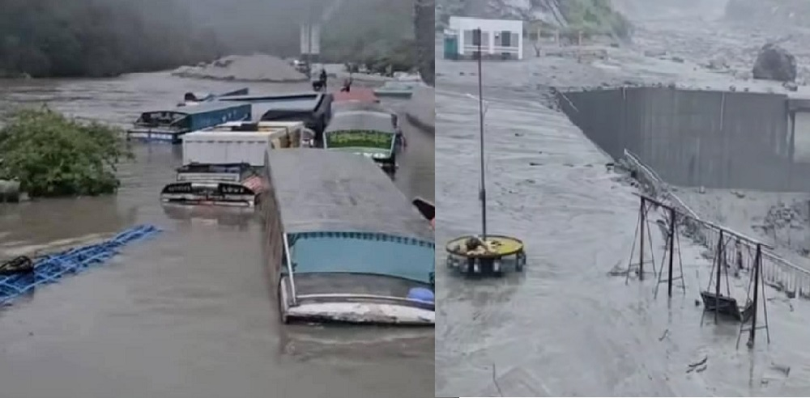
Example: Purepu GLOF (7 July 2025)

Slide 6
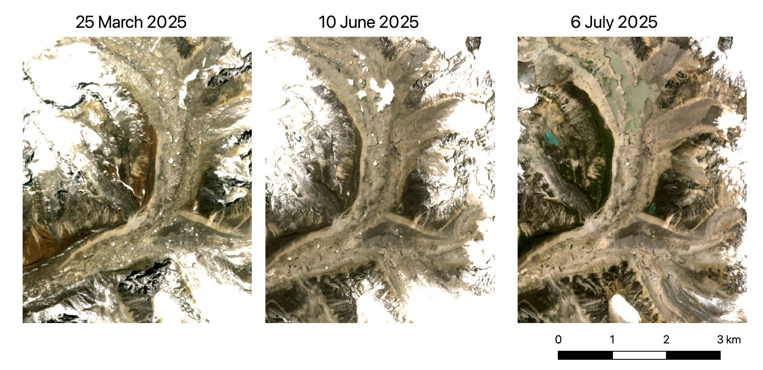

Slide 7
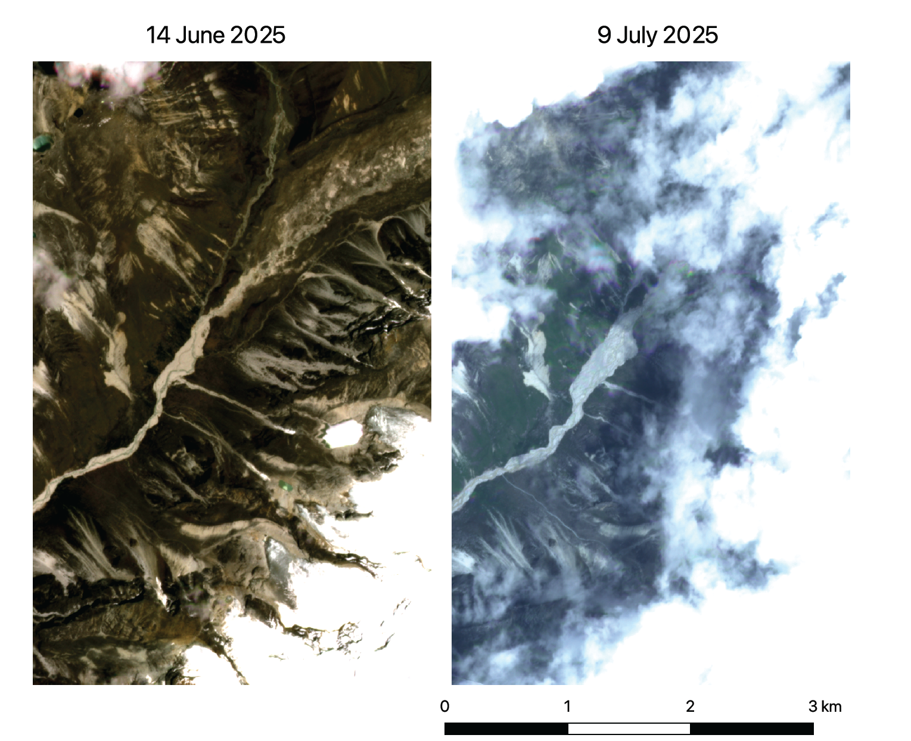

Slide 8
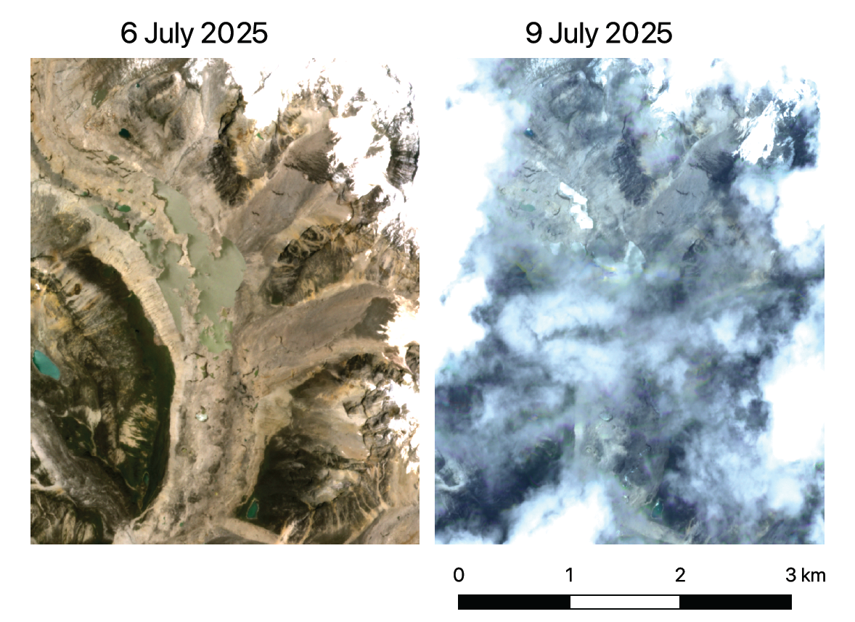

Slide 9
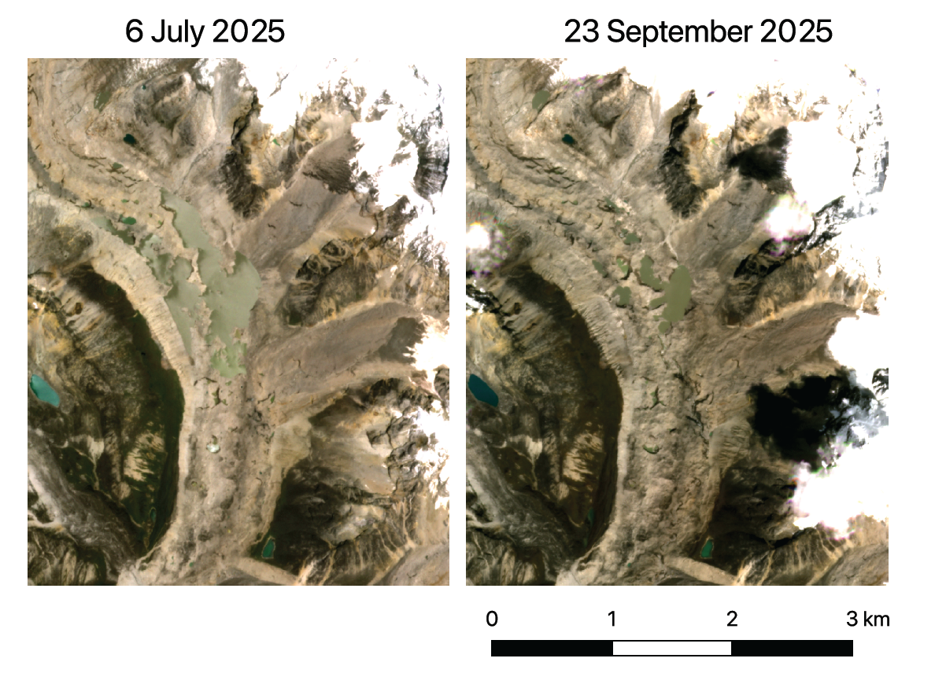

Slide 10
What can we do?
Use planet imagery / SENTINEL to investigate where dangerous supra-glacial lakes develop and how fast and select a few cases to study in more detail?
Investigate the (intra-annual) dynamics of the selected supra-glacial lakes
Time scale of formation (link to melt season)
Analyze temperature trends of glaciers where this occurs
Investigate drainage paths over the glacier surface?
A TC short communication on just the Purepu GLOF
….

